Slide 1

Library Management System
Team Members:
G.NITHEESHA
S.MOHAMMAD
B.DILEEP KUMAR

Slide 2




Introduction: Library Management System in C Using Linked Lists
Project Overview
Key Features
A C-based Library Management System leveraging linked lists for efficient data storage and manipulation.
Add books
Borrow books
Why Linked Lists?
Return books
Search books
Dynamic memory allocation
View all books
Efficient insertion/deletion
Scalability compared to static arrays
System Goals
Provide a user-friendly, robust, and scalable solution for managing library resources.

Slide 3
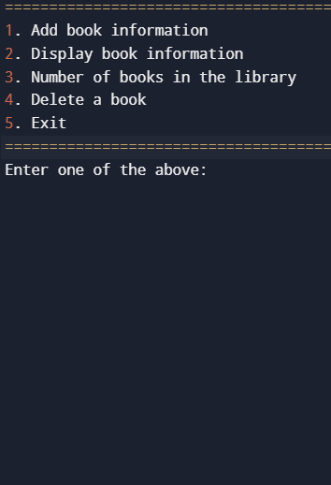



CRUD Operations: Adding and Reading Books
Adding Books (Create)
Reading Books (Read)
addBook(title, author, pages, price) creates a new node in the linked list.
displayBooks() iterates through the linked list and prints book details.
Example: addBook("The Lord of the Rings", "J.R.R. Tolkien", 152, 250)
Searching based on title, author implemented.

Slide 4

CRUD Operations: Updating and Deleting Books
Count of the books(Update)
Count_Books() searches for a total books in the library.
Example: Count of the books().
Deleting Books (Delete)
deleteBook(Title) searches for a book by Title and removes it from the linked list.
Example: deleteBook("The Lord of the Rings")

Slide 5





Conclusion
1
Summary
2
Benefits
The Library Management System effectively uses linked lists to provide core CRUD functionalities.
Dynamic memory allocation, efficient data manipulation, and improved scalability are key advantages.
3
Future Enhancements
Consider implementing a GUI, adding user authentication, and integrating external databases.

